Slide 1
Protask RPG
Peter Janssen & Alexander Deelen – Copodi Gaming™

Slide 2
Index
What is it
Our goals
How is it going to work
Gameplay
Requirements
Planning

Slide 3
What is Protask RPG?
JRPG
Unity
C#
Customizable
Procedurally Generated

Slide 4
Our goals
Create a customizable experience
Learn more about game development
Make something procedural

Slide 5
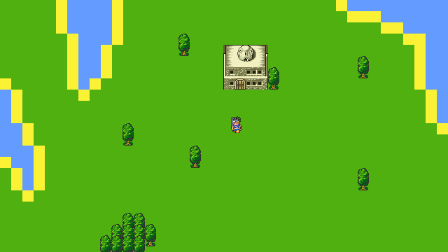
World
Procedurally generated with tiles
Walkable/unwalkable terrain
Possibility of structures

Slide 6
Characters
Custom Character creation
Own stats
Classes

Slide 7
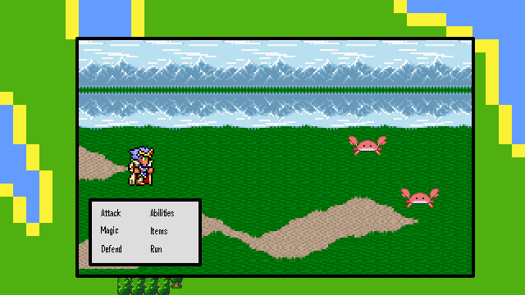
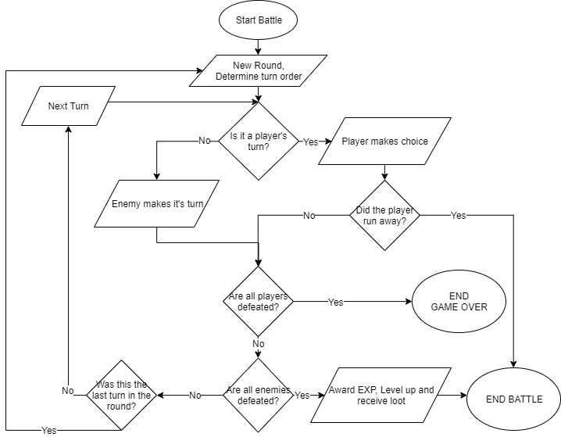
Battles
Flow
Enemies have own stats
Take actions in turns

Slide 8
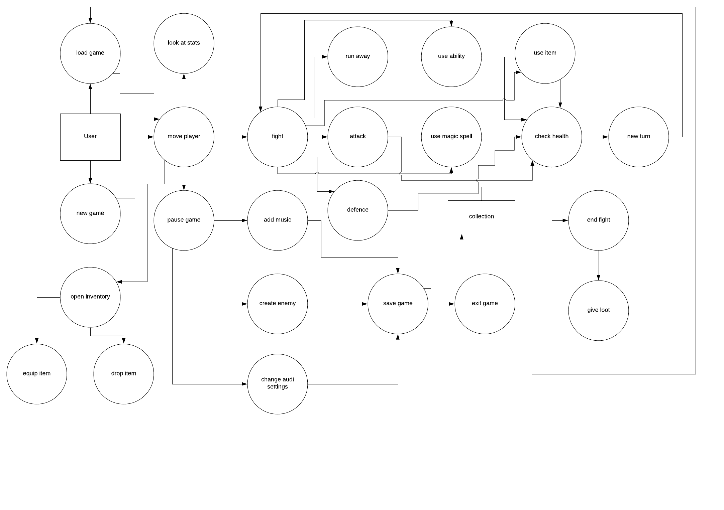
Gameplay loop

Slide 9
Moscow
Must
Japanese-style Role Playing Game (JRPG)
World procedurally generated
Battle System
Actions
Attack (Weapon)
Abilities
Magic Spells
Items
Defend
Run
Turn-based, greatest speed first
Customizability
Custom Music
Custom Enemies
Character Creation
Inventory System
Consumable Items
Equipment
Player Stats
Attack, Defense, Magic, Speed, Luck
Experience System with level-ups
Classes
Classes determine stat growth
Classes have special properties (Magic Spells and Abilities)
Should
No Random Battles in the overworld
Enemies appear on screen, walk into them to start battle
Battles have animation
Enemy idle
Enemy attack
Player attack
Get more Items
Enemy Loot
Treasure Chests in the world
Could
Dungeons and Structures
Random Buildings throughout the world
Towns Possible, low priority
Dungeons aside from main world
Separate Procedural generation
Won’t
Use templates
Static World
Make Apple Version
Use Unity incompatible formats

Slide 10
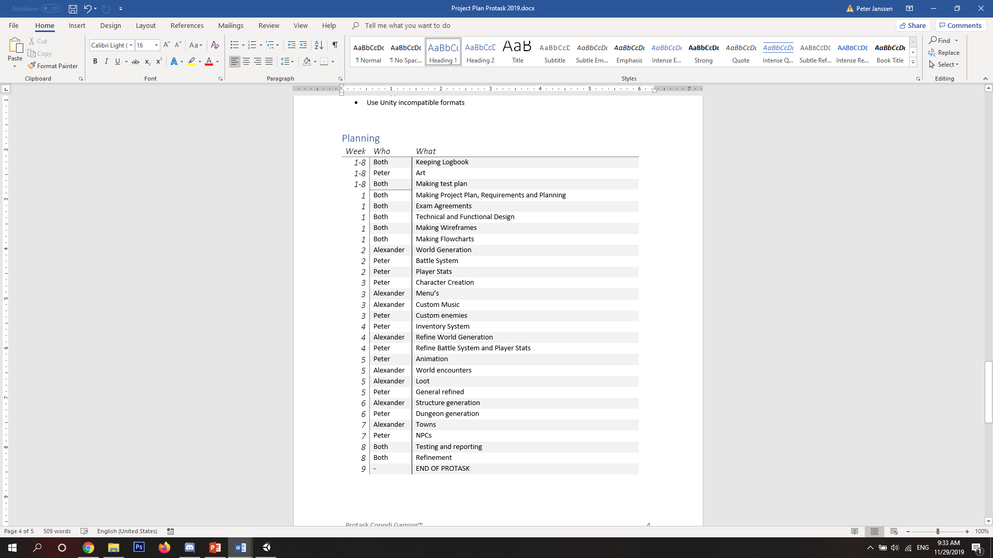
Planning

Slide 11
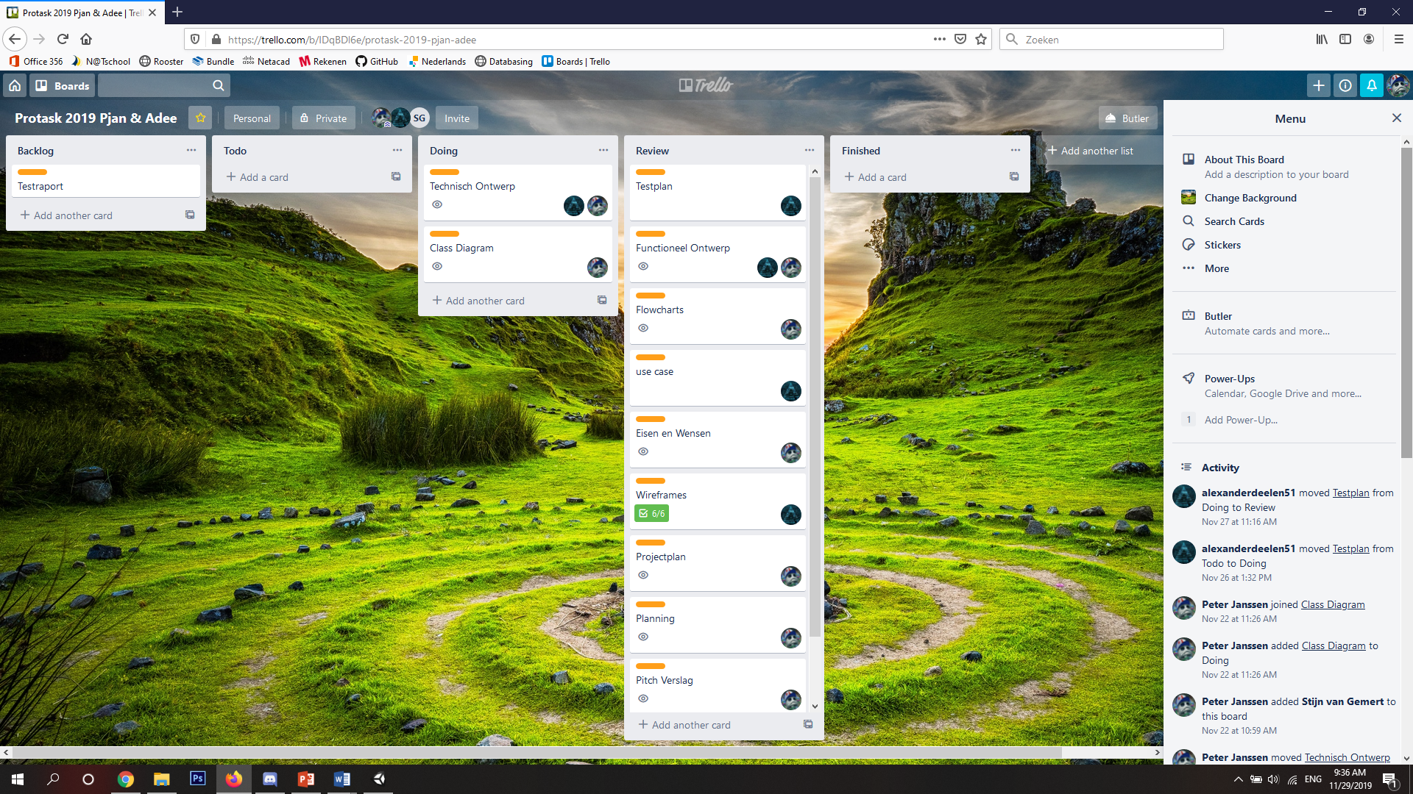
Preperation
Tested Untiy
Made a Git repository
Made a trello

